Slide 1

Fake News Detection and Verification Tool
Built an AI-based Fake News Detection and Verification Tool that analyzes news content and determines its
credibility. The system uses advanced natural language processing and transformer-based models to classify
news as fake, suspicious, or reliable, providing quick and automated verification through a user-friendly
web interface.
Presented by : Arya Nandini (Batch-10)
Presented to : V. Manjuladevi Mam

Slide 2

Introduction
The exponential growth of digital media and social platforms has made information dissemination instantaneous but has also amplified the spread of misinformation. False narratives can influence public opinion, impact democratic processes, and cause real-world harm before verification occurs.
Traditional approaches to fake news detection often rely on pattern matching and statistical models that struggle with nuanced language, context, and evolving deception tactics. Our project leverages the advanced reasoning capabilities of Large Language Models to provide more sophisticated, context-aware verification.
This tool aims to empower users with instant credibility assessment, helping them navigate the complex information landscape with greater confidence and critical awareness.

Slide 3
Problem Statement
There is a critical need for an intelligent, accessible tool that can analyze textual content in real-time, assess credibility across multiple dimensions, and provide clear, actionable insights to users regardless of their technical expertise.
Information Overload
Sophisticated Deception
Limited Access to Verification
Users are bombarded with thousands of articles, posts, and claims daily, making manual verification virtually impossible for the average person.
Modern misinformation employs subtle manipulation techniques, emotional triggers, and partial truths that evade simple keyword-based detection systems.
Existing fact-checking resources are often slow, cover limited topics, and require users to actively seek verification rather than providing proactive assessment.

Slide 4
Project Objectives
01
02
Develop an LLM-Powered Detection System
Design an Intuitive User Interface
Create a robust verification engine using Google Gemini's advanced language understanding to analyze news content for authenticity markers, logical consistency, and credibility indicators.
Build a web-based platform where users can submit text or URLs for analysis, receive immediate feedback, and understand the reasoning behind credibility assessments.
03
04
Implement Multi-Dimensional Analysis
Establish Comprehensive Documentation
Evaluate content across multiple factors including source credibility, emotional manipulation, factual consistency, and linguistic patterns that characterize misinformation.
Maintain detailed records of all analyses in a structured database to enable pattern recognition, improve model performance, and provide transparency in the verification process.

Slide 5





Key Outcomes
Real-Time Verification
Users receive instant credibility assessments of news articles and social media posts, enabling informed decision-making before sharing or acting on information.
Advanced Context Understanding
The system leverages Gemini's natural language processing to understand nuanced context, detect subtle manipulation, and identify sophisticated misinformation tactics.
Accessible Platform
Impact: Automated verification tools can reduce the spread of misinformaton by up to 80% when integrated into content distribution platforms.
A clean, responsive web interface makes the tool available to non-technical users, democratizing access to advanced verification technology.
Analysis Repository
All verification results are stored systematically, creating a valuable dataset for research, pattern analysis, and continuous improvement of detection algorithms.

Slide 6






System Overview
Our fake news detection tool operates as a comprehensive web application that seamlessly integrates user interaction, intelligent processing, and persistent storage. The system accepts textual input or URLs from users through an intuitive frontend interface.
User Input
Submit news text or article URL via web interface
Frontend Processing
Validate and format submission data
Backend Analysis
Flask API coordinates verification workflow
LLM Evaluation
Gemini analyzes credibility and generates assessment
Results Display
Present verification findings to user
The backend Flask application orchestrates the verification process by communicating with Google Gemini's API, which performs sophisticated natural language analysis to assess credibility. Results are stored in a relational database for future reference and returned to the user with detailed explanations of the credibility assessment, empowering informed decision-making.

Slide 7
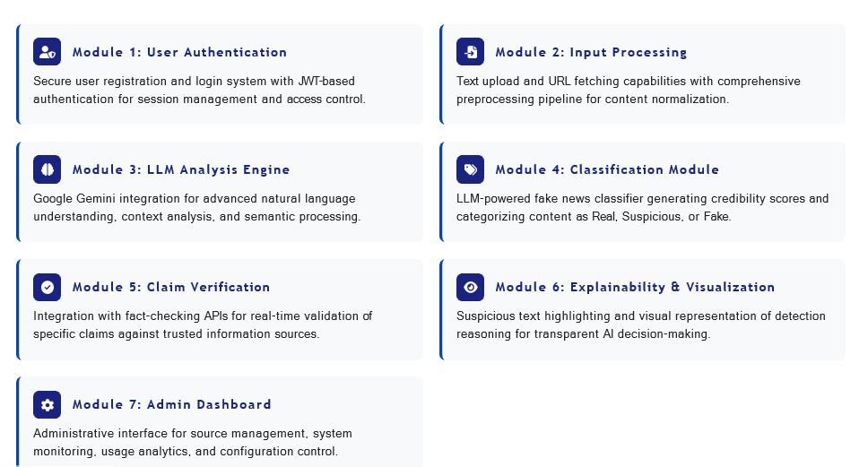
Modules to be Implemented
User Authentication Module
Analysis Engine Module
Secure user registration and login
Multi-factor credibility scoring
Session management
Pattern recognition
Profile management
Result generation and formatting
Input Processing Module
Database Management Module
Text input validation
User data storage
URL content extraction
Analysis history tracking
Data sanitization and formatting
Query optimization
LLM Integration Module
Reporting Module
Gemini API connection
Detailed credibility reports
Prompt engineering for verification
Visual result presentation
Response parsing and interpretation
Export functionality

Slide 8

System Architecture
The architecture follows a modern three-tier design pattern, ensuring separation of concerns, scalability, and maintainability. Data flows seamlessly from user interaction through intelligent processing to persistent storage.
Response Return
User Interface
Result routed back to user
Web browser interaction
Database
System Architecture Flow
Frontend Layer
PostgreSQL / SQLite storage
HTML/CSS/JavaScript
Google Gemini LLM API
Backend API
Analysis and inference
Flask server endpoints
Presentation Layer
Data Layer
The frontend provides responsive web interfaces for user interaction, built with modern HTML5, CSS3, and JavaScript frameworks to ensure cross-platform compatibility.
Application Layer
Relational database stores user profiles, submission history, and analysis results with proper indexing for efficient retrieval and reporting.
Flask-based REST API handles business logic, coordinates LLM communication, manages authentication, and orchestrates the verification workflow.

Slide 9



Tech Stack Used :
Python 3.8+
Core programming language providing extensive libraries for data science, machine learning, and web development
Flask Framework
Lightweight web application framework enabling rapid API development and template rendering
NLTK s spaCy
Natural Language Processing libraries for tokenisation, lemmatisation, and linguistic analysis
AI / ML Transformer-based Deep Learning Models (BERT, RoBERTa, DistilBERT)
The technology stack leverages open-source tools ensuring accessibility, community support, and cost-effectiveness. Python's ecosystem provides seamless integration between data processing, machine learning, and web deployment components. The combination of NLTK for linguistic preprocessing and Scikit-learn for classification creates a robust pipeline capable of handling diverse textual inputs whilst maintaining high accuracy.

Slide 10

Database Schema
The database architecture consists of two primary tables that capture user information and analysis results. This relational structure ensures data integrity, efficient querying, and comprehensive record-keeping for all verification activities.
Analysis
analysis_id PK, user_id FK, input_text, verification_result, credibility_score, analysis_timestamp, gemini_response
Users
user_id PK, username, email, password_hash, created_at, last_login
Users Table
Analysis Table
Stores authenticated user accounts with secure password hashing. Tracks account creation dates and login history for security auditing and user engagement analysis.
Maintains comprehensive records of all verification requests and results. Links each analysis to the requesting user and preserves full context for future reference and pattern analysis.
user_id: Primary key (auto-increment)
analysis_id: Primary key (auto-increment)
username: Unique identifier (varchar)
user_id: Foreign key to Users table
email: Contact information (varchar)
input_text: Submitted content (text)
password_hash: Encrypted password (varchar)
credibility_score: Numerical rating (float)
created_at: Registration timestamp
verification_result: Assessment summary (text)
analysis_timestamp: Submission time

Slide 11
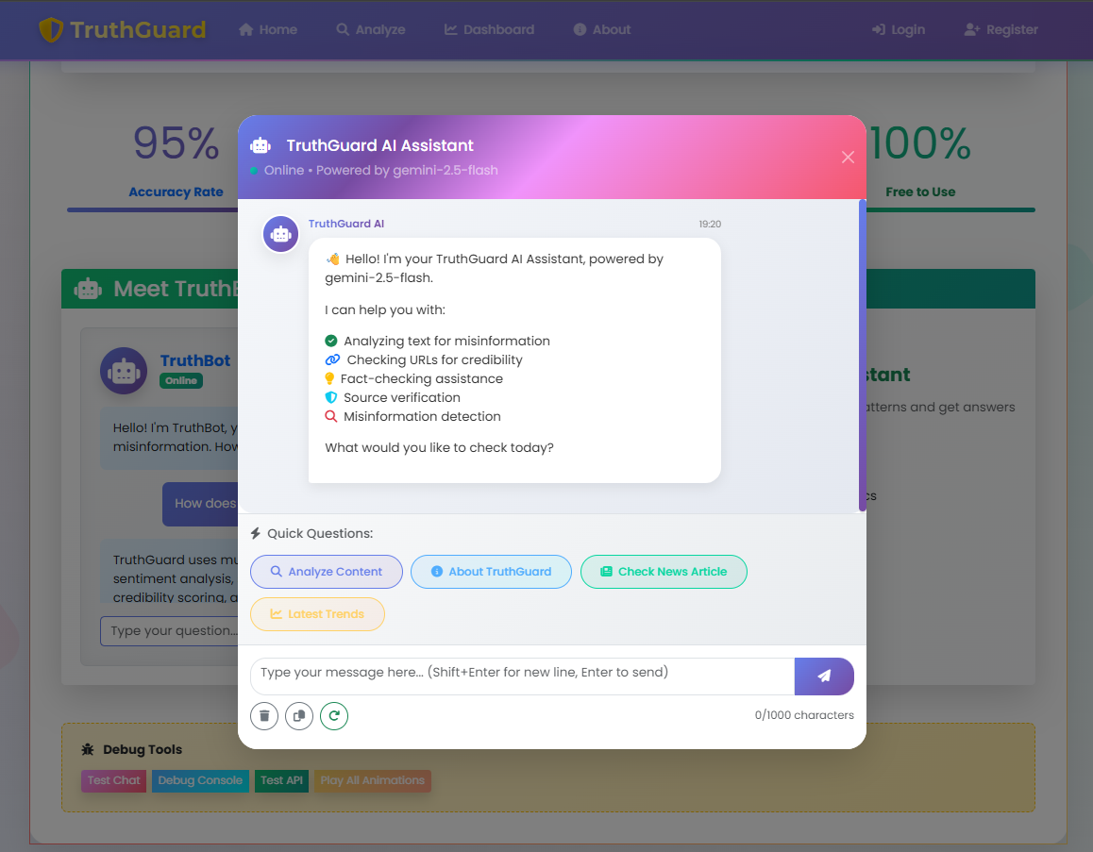
Sample Output
The screen displays the output interface generated by the Fake News Detection and Verification Tool. The user submits news text through the web-based interface, which is processed by the backend system. The input undergoes validation and semantic analysis using transformer-based language models. Based on the contextual understanding of the content, the system generates a credibility classification as Fake, Suspicious, or Reliable, along with a confidence score indicating the reliability of the prediction. The analyzed results are displayed to the user and can be stored for future reference and analysis.

Slide 12
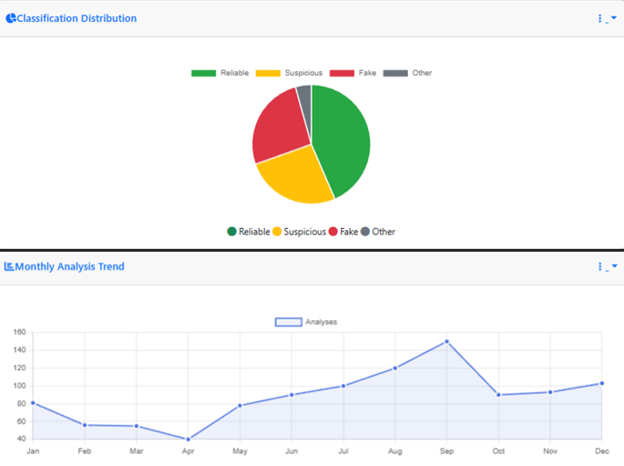
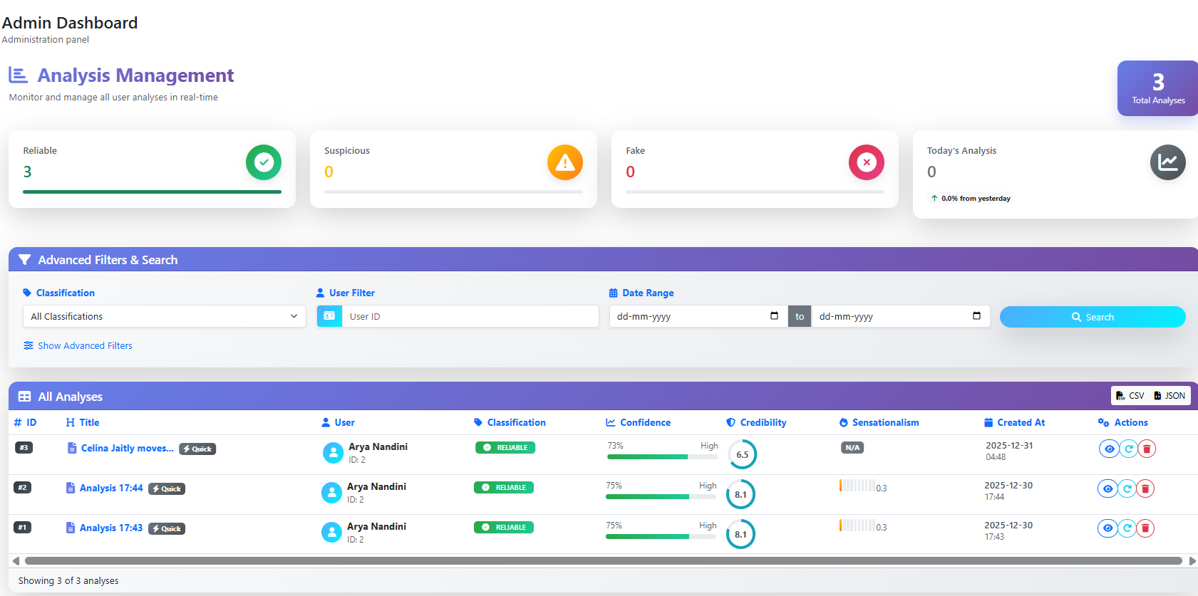
Sample Output
The figure presents the analytical dashboard generated by the Fake News Detection and Verification Tool. It provides a visual summary of news classification results, including the distribution of Reliable, Suspicious, and Fake news through graphical representations. The dashboard also displays monthly analysis trends, allowing users and administrators to observe patterns and variations in misinformation over time.
Additionally, the system includes an analysis management panel where individual news verification records are listed along with their classification results, confidence scores, and credibility indicators. Advanced filtering options enable efficient searching and monitoring of analyzed content. This output demonstrates the system’s ability to not only classify news accurately but also support tracking, monitoring, and data-driven decision-making.

Slide 13
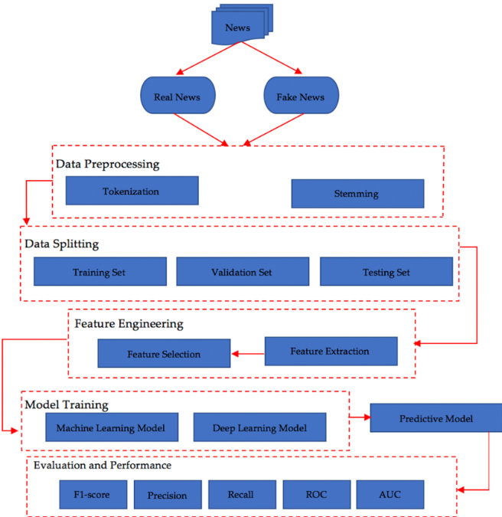
Conclusion and Future Enhancements
🔹 Project Summary
This project successfully implements an AI-based Fake News Detection and Verification Tool designed to assess the credibility of news content. By leveraging natural language processing and advanced language models, the system analyzes news articles and classifies them as Fake, Suspicious, or Reliable. The solution demonstrates how modern AI techniques can be applied to address the growing challenge of misinformation in digital platforms through an automated and scalable approach.
🔹 Technical Achievements
The system achieves reliable performance through effective text preprocessing, semantic analysis, and AI-driven classification. Its modular architecture simplifies maintenance and future upgrades, while the Flask-based web interface ensures ease of use and accessibility. The integration of confidence scoring and result storage further enhances transparency and practical usability.
🔹 Future Enhancements
Support for multiple languages to expand global usability
Real-time verification using live news and social media APIs
Browser extension for instant fact-checking while browsing
Detection of fake images and videos alongside text-based news
Advanced analytics dashboard for trend and credibility analysis

Slide 14
THANK YOU !!

